Slide 1
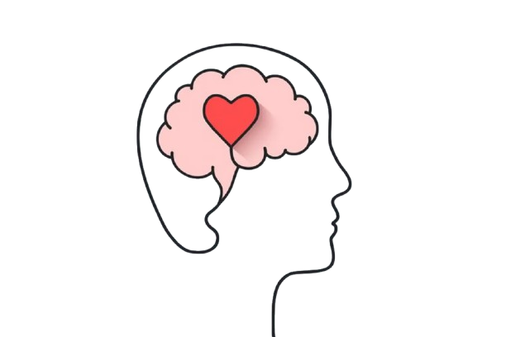
EIRENE
Your Path to Peace.
Group No : 7 Chetan Ravichandra Kajol Dubey Kunal Singh Priyal Panda Suraj Hipparge

Slide 2

What is Eirene ?
An app offering tailored meditations, binaural beats for relaxation, and instant connections with licensed psychologists for real-time, private chat sessions.
Whether you’re seeking stress relief, focus, or mental clarity, Eirene is here to support your journey to wellness.

Slide 3

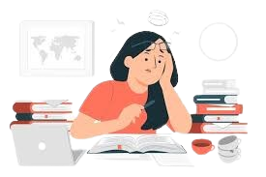
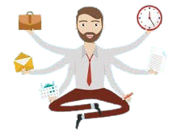
User Persona
Sarah – The Stressed Student
David – The Busy Professional
Emily – The Mindful Traveler

Slide 4
Product Requirements Document (PRD)
Here is the link to our PRD
Eirene-PRD

Slide 5
Prototype
Eirene

